Slide 1
CS575: Software Design Reactive Systems

Slide 2
Tonight's Focus…
Examination of software engineering principles for designing modern applications
Examination of reactive architectures to support the creation of modern applications

Slide 3
Moving from Scale-Up to Scale-Out architectures
The only way to cost-effectively run a modern resilient applications is to embrace a scale-out over a scale-up approach. This, however, introduces some challenging software engineering problems that need to be dealt with.

Slide 4

Design best practices for modern applications
12 software design practices proposed by Herouku (https://www.heroku.com/) for building modern scalable apps
More recently updated with 15 practices by Pivotal - although foucsed on building highly scalable and reliable cloud-applications – they represent good modern software design principles

Slide 5
Design best practices for modern applications
One codebase, one application
API first
Dependency management
Design, build, release, and run
Configuration, credentials, and code
Logs
Disposability
Backing services
Environment parity
Administrative processes
Port binding
Stateless processes
Concurrency
Telemetry
Authentication and authorization
These practices apply towards modern distributed apps – web, mobile, cloud, IoT

Slide 6
1. One Codebase
A codebase for an application is used to create any number of immutable releases that are likely destined for different environments

Slide 7
2. API First
Service
API
Service
API
API
API
Service
Service
All externally visible application interfaces are exposed via well-defined APIs. Define the API-interfaces first for clients and other services

Slide 8
3. Dependency Management
Your Code
Build Process
Dependencies
Runnable Application
Never rely on the existence of system-wide dependencies. Explicitly declare all dependencies (and versions) pulling them in dynamically at build time (maven, sbt, npm)

Slide 9
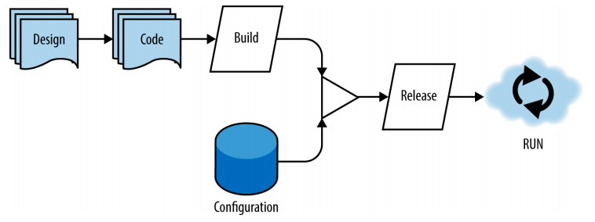
4. Design, Build, Release and Run
Every release is coordinated via an automated build process that injects the proper runtime configuration. Supports a CI/CD pipeline

Slide 10
5. Configuration, Credentials and Code
Configuration
Runtime Container
Database
Runtime Environment
Security Credentials
Deploy Process
Hostnames
Running Code
Runnable Code
Treat configuration as code – configuration is everything likely to change between deploys. Ideally deployment configuration changes are injected into the runtime as environment variables

Slide 11
6. Logs
Runtime Container
Log Aggregation
Utility
Utility
EVENT
App
LOG
LISTEN
LISTEN
LOG STREAM
Runtime Container
LISTEN
LISTEN
EVENT
App
LOG
Utility
Utility
Logs provide insight into the behavior of a running app. Logs should be considered as an event stream, capturing all events from a system in a time ordered sequence. Each app instance is only concerned writing locally to its log, aggregation and streaming are handled outside of the application runtime

Slide 12
7. Disposability
Application instances should be able to be started quickly, and terminate cleanly. Repair is never done, instances are disposed and replaced. Favor light/thin frameworks over heavy/fat middleware. This is the key enabler towards scaling out versus scaling up

Slide 13
7. Backing Services
Treat backing services as attached resources. They are attached via a URL or other location and and security credentials managed by the config. Resources should be able to be attached and detached to the application on demand without any code changes.

Slide 14
9. Environment Parity
Time
Becomes more important as the check-in to deployment cycle time decreases. Days? Months? Minutes
People
Specialized Skillsets, or “if you build it, you deploy and run it”
Resources
Expensive, specialized resources (Oracle DB), or general purpose open source (Postgress)
Keep all environments as similar as possible. Need to avoid ”it works on my machine” scenario. Might be impossible to totally maintain consistency, but it should be maximized as much as possible. Can be mitigated with other factors such as Backing Services, Configuration as Code, etc

Slide 15
10. Administrative Processes
Runtime Container
Application Code
Timed or scheduled activities (Backups)
Application User
Administration Code
Administrator at Terminal (REPL)
Run administrative and management tasks as one-off processes. Admin code should be managed and deployed with the underlying application code. Admin actions should execute in the same runtime configuration as the underlying application

Slide 16
11. Port Binding
Runtime Container
Service Discovery
Runtime Environment
(Config)
Advertise
Discover
Running Code
Bootstrap
To Port
Discover
Export services via port binding. Use a service discovery mechanism to locate and bind to other services. Examples, ETCD and Consul – basically a highly dynamic DNS service

Slide 17
12. Stateless Processes
Runtime Container
Backing Services for State
Application Code
Database
Application User
Distributed Cache
Services should be “share nothing” and stateless. Any state or persistence operations should be handled in a backing service such as a cache or database. This is a key attribute of resiliency and scale

Slide 18
13. Concurrency
Scale out via the process model. Dynamically be able to start and stop various aspects of your application based on load or needs. This is different from a scale-up model where scaling involves increasing all services equally.

Slide 19
14. Telemetry
Runtime Container
INSTRUMENTATION STREAM
Runtime Environment
(Config)
Telemetry Data
LISTEN
LISTEN
Running Code
Application Code
ALERTS
Built-In Instrumentation
Admin Console
Rules Engine
Slack, SMS, etc
All well designed application have built in instrumentation to communicate on application health (e.g., performance, errors, resources, etc)

Slide 20
15. Authentication and Authorization
Runtime Container
Runtime Container
Application Code
Application Code
Application User
Security Enforcement Point
Security Enforcement Point
Every request to your application should know about who (person or service) who is making the request and the roles that they have that dictate access. See OIDC and oAuth as examples.

Slide 21
What are reactive applications?
”React” to requests from users and other application components ALWAYS in a predictable and expected way
“React” to failure
“React” to load
“React” to messages / events
…versus traditional applications?
Service requests from users and components as needed to the greatest extent possible
Test against failure conditions
Stress tested to work against an anticipated load
Reply to requests as they arrive

Slide 22
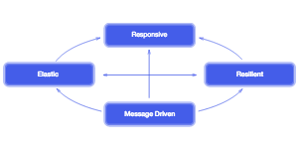
The reactive manifesto highlights desirable aspects of modern applications
the system responds timely with consistent responsiveness
Responsive
responsiveness maintained under varied workloads
responsiveness maintained in the face of failure
Elastic
Resilient
Message Driven
component boundaries traversed using asynchronous messages
Foundations of reactive architectures go back to the 1970s with the work that Erickson did in the telecom space with the Erlang language. They have been rediscovered and extended with work done at Microsoft on reactive extensions for .Net. Now there are several library choices for implementing reactive architectures based on some pioneering work by NetFlix with RxJava, TypeSafe with Akka, and Spring with Reactor.
http://www.reactivemanifesto.org/

Slide 23
Its safe to say that almost all new systems are distributed and designing solutions for them is not easy
Why distributed systems, we need them for:
Scalability
Availability
Building rich, stateful clients (HTML5)
But there are several problems that have to be overcome
Many moving parts
No way to tell the difference from a slow node and a dead node
Network reliability and latency
Coordination

Slide 24
The fallacies of distributed computing
The network is reliable.
Latency is zero.
Bandwidth is infinite.
The network is secure.
Topology doesn't change.
There is one administrator.
Transport cost is zero.
The network is homogeneous.
All of these issues need to be handled to build good distributed systems
http://en.wikipedia.org/wiki/Fallacies_of_distributed_computing

Slide 25
Not to Mention Programming Models for Distributed Systems are Also Complex
Coordination with low-level locks
Callbacks
Future / Promises
Generators / Async-Await
Other Specialized Architectures - Actors

Slide 26
Callbacks
getData(function(a){
getMoreData(a, function(b){
getMoreData(b, function(c){
getMoreData(c, function(d){
getMoreData(d, function(e){
...
});
});
});
});
});
Benefits – Simple for event based reactive programming
Challenges – Flow Control, Exception Handling

Slide 27
Promises
getDataAsPromise()
.then(function(a){ return getMoreDataAsPromise(a); })
.then(function(b){ return getMoreDataAsPromise(b); })
.then(function(c){ return getMoreDataAsPromise(c); })
.then(function(d){ return getMoreDataAsPromise(d); })
.then(function(e){
...
})
Benefits – Simple for event based reactive programming, Easy Nesting, Simple to sequence events, exceptions propogated upward
Challenges – Flow Control Beyond Sequencing

Slide 28
Generators
function *getDataWithGenerator() {
let a = yield getData();
...
let b = yield getMoreData(a);
let c = yield getMoreData(b);
let d = yield getMoreData(c);
let e = yield getMoreData(d);
return e;
}
let result
for (let d = getDataWithGenerator()){
if(d.done)
result = d.value
}
//note that generators return an object in the form of
//{value: x, done: true/false}
Benefits – Makes asynchronous code look synchronous
Challenges – The fact that yield returns right away and a generator is basically an iterator makes processing the results a bit strange. Not widely available in many languages

Slide 29
Async / Await
async function getDataWithAsyncAwait() {
let a = await getData();
...
let b = await getMoreData(a);
let c = await getMoreData(b);
let d = await getMoreData(c);
let e = await getMoreData(d);
return e;
}
getDataWithAsyncAwait().then( e => {
//process results
}
Benefits – Makes asynchronous code look synchronous, very clean
Challenges – Not widely available in many languages – just being introduced into Javascript, exists in C#, not sure about other languages

Slide 30
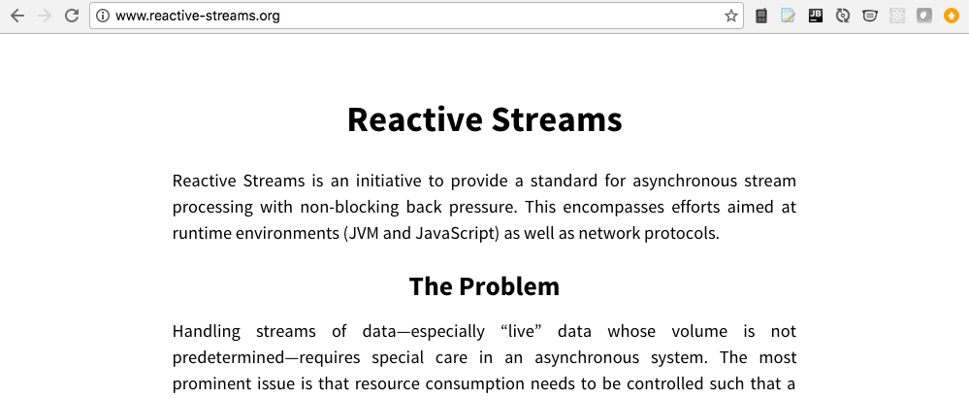
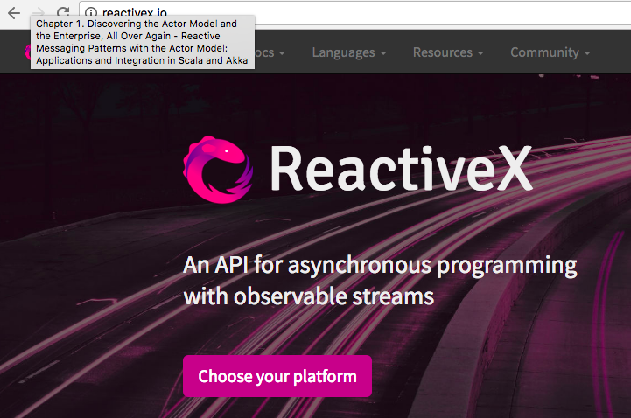
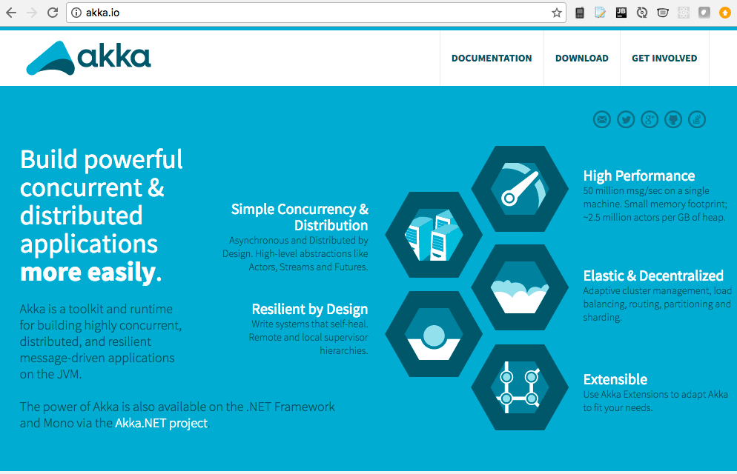
Reactive Streams
Benefits – Turns asynchronous constructs into functional programming constructs
Challenges – Not many, widely available ReactiveX.io, Java/Scala/.Net Akka, other implementations for languages like Python, etc.

Slide 31
Typical patterns based on shared-mutable state don’t scale and lead to many problems, message-driven architectures offer a solution
Requires embracing non-blocking and asynchronous techniques to scale
Learn from problems with previous architectures that had problems because of shared-mutable state
Synchronous RPC
Distributed objects
Design drivers
Partition for scale
Replicate for resilience
Characteristics of designs that scale
Share nothing
Loose Coupling
Use Asynchronous communication
Location transparency
One of the architectures that support all of the design characteristics for scale are based on using messages to traverse asynchronous boundaries, and events to coordinate them

Slide 32
We also need architectures that handle different types of asynchronous boundaries consistently
Types of Asynchronous Boundaries
Between Threads
Between CPUs
Between Processes
Between Applications
Between Network Nodes
The problem is not traversing the boundaries, its coordinating the flow of data across the boundary. Some solutions:
Blocking calls, request/reply
Store and forward queues, need to deal with challenges when supply of messages exceeds demand (drop messages)
Reactive: Non-Blocking, Non-Dropping, and Bounded
Of course, this assumes that you used other techniques to eliminate shared mutable state that kills concurrency. To coordinate shared state requires the use of locks, synchronized blocks, semaphores, atomic operations, and other techniques that are complex to get correct.

Slide 33
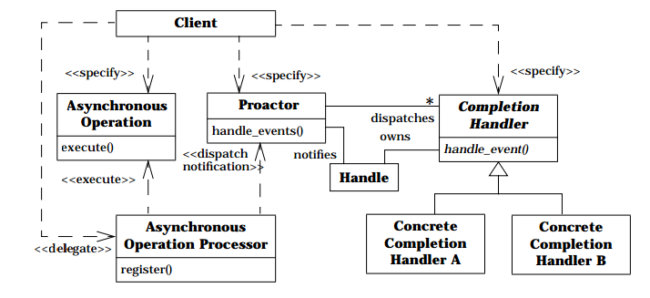
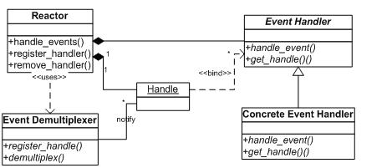
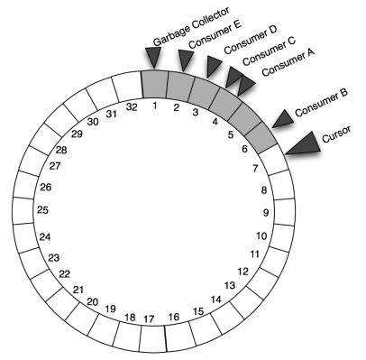
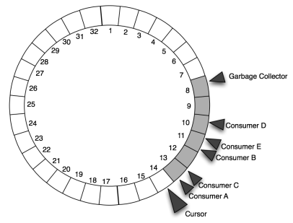
Event driven systems based on message passing are required for reactive systems to tame the shared mutable state problem, and we have seen architectures for them before
Proactor
Reactor
LMAX Ring Buffer
After Some Time

Slide 34
Building resilient solutions - challenges
Resilient systems must embrace the inherent unreliability of distributed systems, but this is not easy
Typical error handling techniques are are based on defensive programming
Traditional techniques in non-distributed systems (e.g., Try/Catch) do not scale or work with distributed systems
If you are working in a single thread, and it blows up, there is no way to recover from that
In distributed systems errors don’t propagate across threads or network boundaries, so other solutions are needed
Defensive programming techniques for dealing with errors typically get mixed-in with other code, and is scattered across the entire codebase

Slide 35
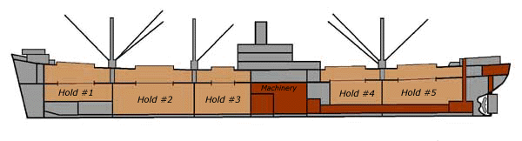
Solutions for building resilient solutions
Isolate
Compartmentalize
Mange failure locally
Avoid cascading failures
Consider the way ships are built with bulkheads to isolate parts of the ship from each other

Slide 36
Resiliency Patterns – Circuit Breaker
Lets see how to configure a CircuitBreaker with the following parameters:
5 maximum failures
a call timeout of 10 seconds
a reset timeout of 1 minute
Why use a CircuitBreaker?
Prevents cascading failures by eliminating a lot of retries
Users know of failures fast versus uncertainty of if a service is down or just slow
https://github.com/Netflix/Hystrix/wiki/How-it-Works#CircuitBreaker
http://doc.akka.io/docs/akka/current/common/circuitbreaker.html

Slide 37
Resiliency Patterns – Circuit Breaker
class DangerousActor extends Actor with ActorLogging {
import context.dispatcher
val breaker =
new CircuitBreaker(
context.system.scheduler,
maxFailures = 5,
callTimeout = 10.seconds,
resetTimeout = 1.minute).onOpen(notifyMeOnOpen())
def notifyMeOnOpen(): Unit
log.warning(”OPEN and will not close for one minute")
def dangerousCall: String = "This might be bad"
def receive = {
case ”proxy_async" =>
breaker.withCircuitBreaker(Future(dangerousCall))
pipeTo sender
case ”proxy_sync" =>
sender !
breaker.withSyncCircuitBreaker(dangerousCall) }
}

Slide 38
Designing for resiliency
Isolate & Compartmentalize: Execute in lightweight compartmentalized (share-nothing) processes
Provide centralized supervision of the processes
Each process has a supervising parent, the parent can supervise one or more children
Errors, when detected are redirected asynchronously to the parent
The supervisor can handle via kill, restart, retry, or suspend/resume operations
This model decouples error handling from the actual service logic

Slide 39
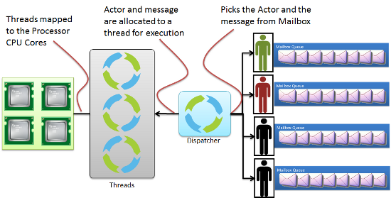
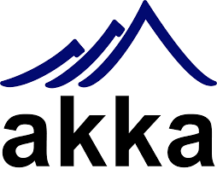
Designing for resiliency – The “Actor” Model
The actor model originated in 1973, and became an integral part of the Erlang programming language. Erlang needed a solution for high-concurrency to support telecom applications. The Scala implementation of the Actor model is called akka.

Slide 40
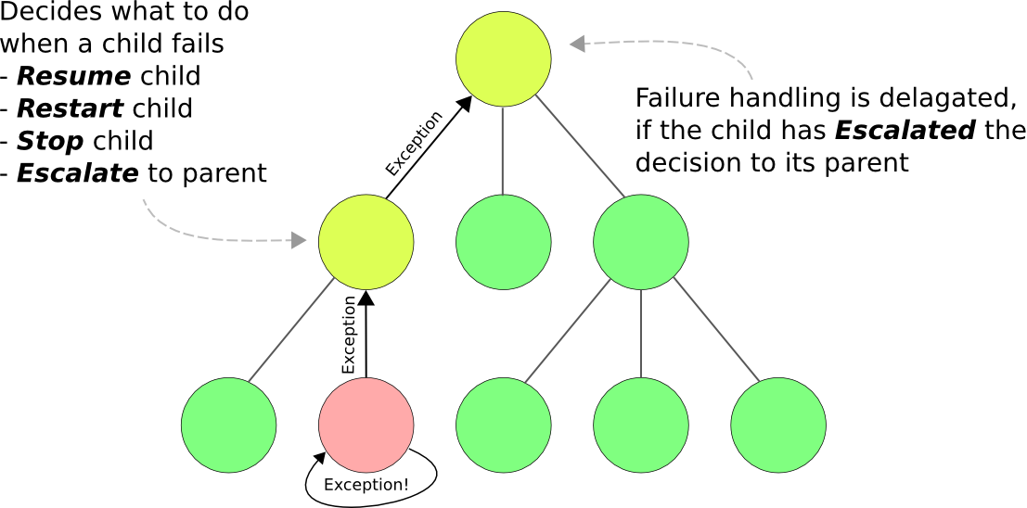
Designing for resiliency – Using hierarchies in the actor model for supervision

Slide 41

Responsiveness in Reactive System
Reactive systems need to ensure that systems remain responsive under different workloads
Expected workloads
Traffic bursts
Unexpected and unanticipated scenarios
Consider Little’s Law from Queuing Theory
OR Queue Length = Arrival Rate * Response Time … or… Response Time = Queue Length / Arrival Rate
We need a way for to balance supply with the demand to ensure that the system remains responsive and does not fail under unexpected demand

Slide 42
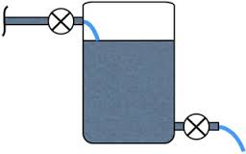
The need for back-pressure. To avoid failures we need a technique to balance supply with demand
At some point the system becomes unstable
At this point having the server continue to send data does not make sense as the client cannot efficiently handle it. The solution is to apply “back pressure”.
Backpressure is based on the idea that the client tells the server that it can accept a certain amount of messages to avoid being overloaded
Backpressure is a technique to that helps to auto-balance supply versus demand
Consider what happens when the bucket fills up
Response Time (Based on consistent time to process events)
Depth of Queue (as load Increases relative to the ability to process events)

Slide 43
The need for back-pressure. To avoid failures we need a technique to balance supply with demand
Objective 1:
How do we guarantee we stay to the left of this line?
Objective 2: If we cross the line how do we stop the system from becoming unstable?
Response Time (Based on consistent time to process events)
Depth of Queue (as load Increases relative to the ability to process events)

Slide 44
The Scala API shows how the publication/subscription process works, backpressure is managed via the request(n) function on the subscription
Publisher
Subscriber
trait Publisher[T] {
def subscribe(s: Subscriber[T]): Unit
}
trait Subscriber[T] {
def onSubscribe(s: Subscription[T]): Unit def onNext(elem: T): Unit
def onError(t: Throwable): Unit
def onComplete(): Unit
}
trait Subscription[T] {
def cancel(): Unit
def request(n: Long): Unit
}
Subscribe
subscription
onSubscribe
request
onNext
onNext
This is how backprssure is applied
…
onError
onComplete

Slide 45
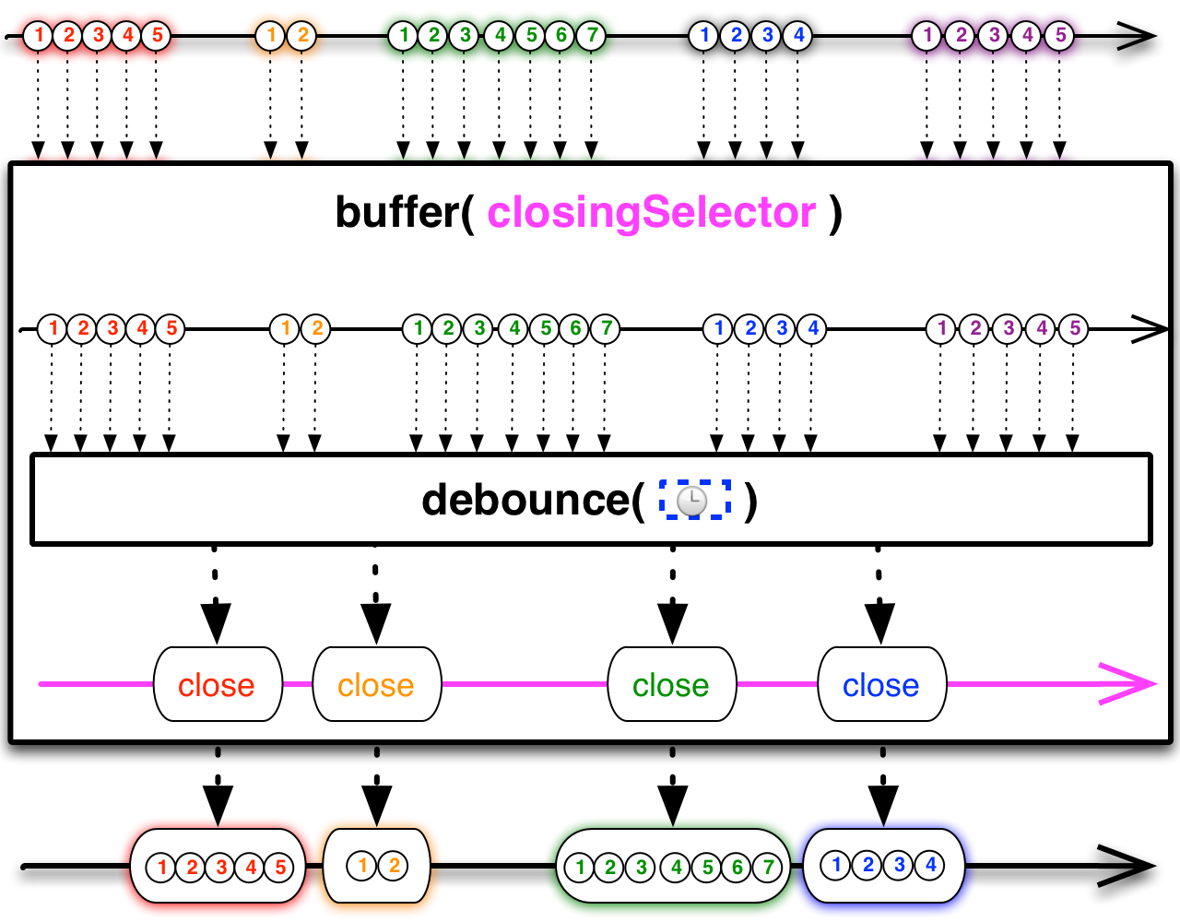
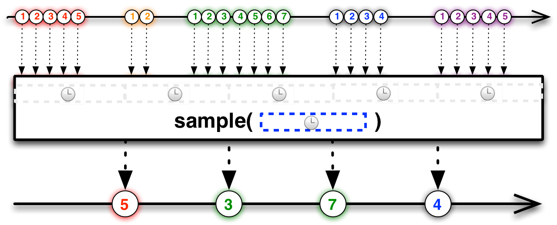
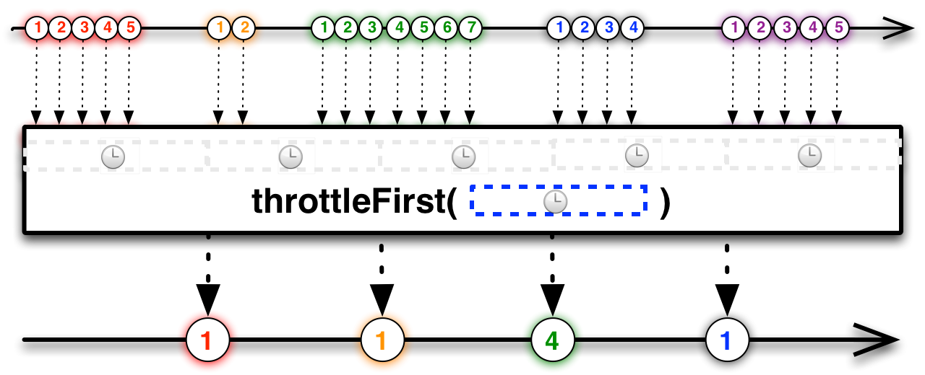
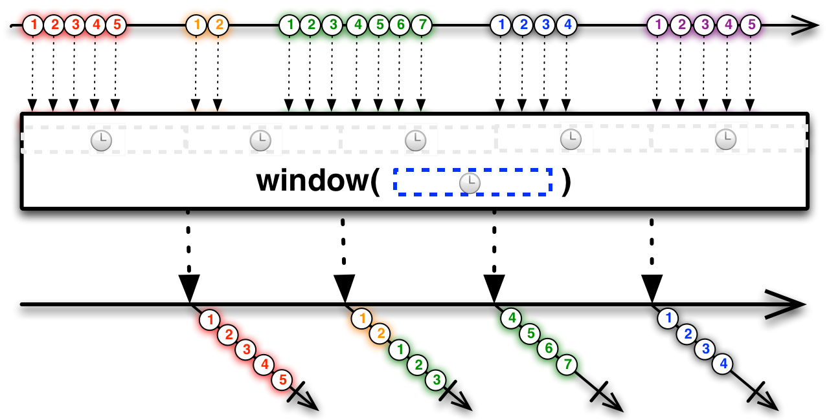
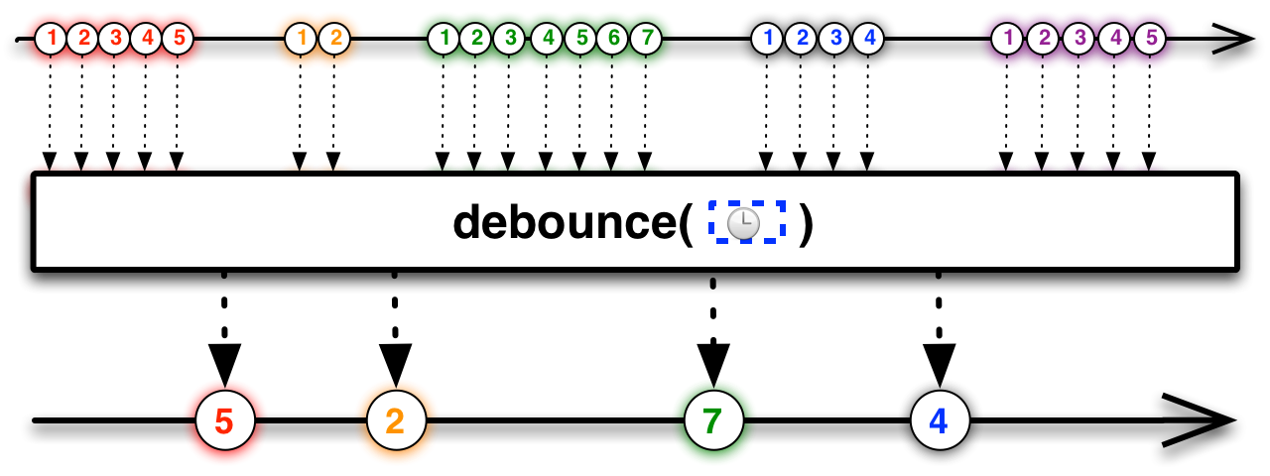
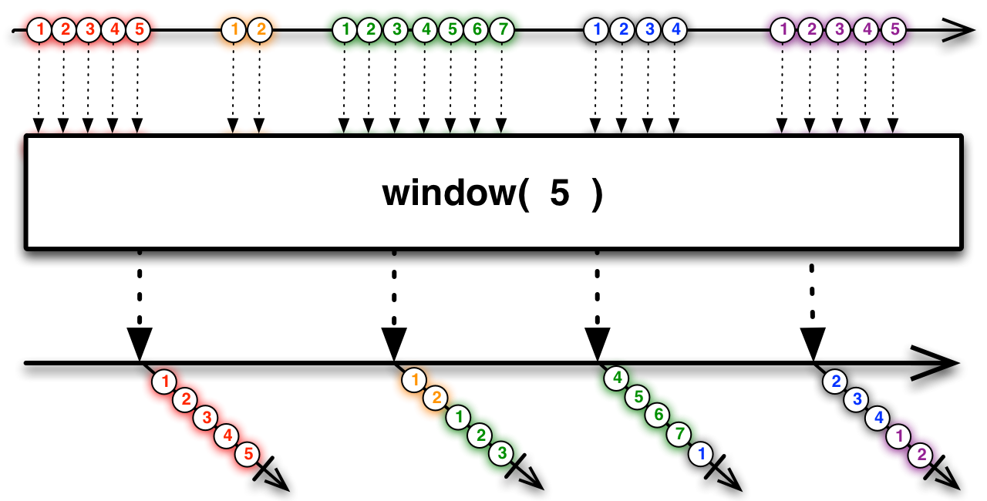
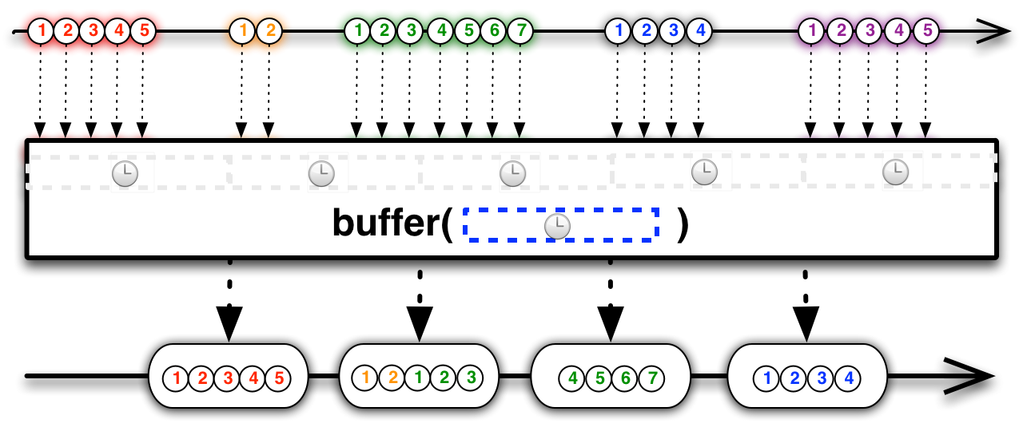
Or use operations that help with flow management – alternatives to direct back pressure technique

Slide 46
To see how we can get to a good architecture, lets start by reviewing a reference architecture for SOA

Slide 47
This architecture promotes 5 key areas of focus
3
Enrich
1
Create
2
Compose
4
Manage & Secure
5 Consume

Slide 48
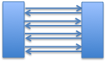
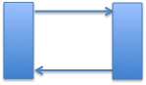
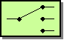
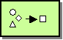
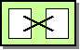

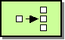
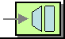
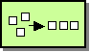
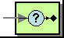
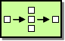
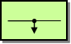
To enable clients to work at an appropriate level of abstraction we need to be able to compose granular services to meet our application requirements
✓
Options….
Use established EAI Frameworks? Use Functional Reactive Methods?

Slide 49



Example: getCustomerSummary using EAI Server Framework
FLOW: CustomerSummary
getCustomers()
SPLIT
getOrders()
AGGREGATE
getBillingDetails()
DEPLOY
EAI Server on JVM
At Cigna we currently are using both Spring Integration and Apache Camel in production

Slide 50
While good, EAI frameworks only focus on one of the aspects in our targeted architecture
the system responds timely with consistent responsiveness
Responsive
responsiveness maintained under varied workloads
responsiveness maintained in the face of failure
Elastic
Resilient
Message Driven
component boundaries traversed using asynchronous messages
Other specialized servers and infrastructure are required to help meet targeted Elastic, Resilient and Responsive needs.
Notes:
EAI Frameworks provide patterns for creating higher-level composed abstractions efficiently. They have good support for asynchronous message passing; however, they rely on other technologies for the other reactive aspects that are only partially realized.

Slide 51
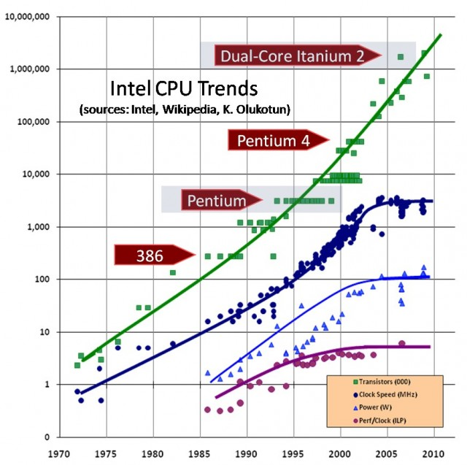
In order to understand the problem, we need to revisit Moore’s law…
More Cores = Harder Software
Around 2005 we started to see clock speed and performance of CPUs level off. Performance is now increased by having multiple-cores on a chip, but this causes complexity that our software needs to deal with…

Slide 52
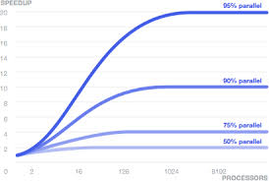
Amdahl’s law also comes into play when trying to determine the maximum speedup that can be achieved
This means to scale we also need to avoid parts of a system that need to be coordinated across an async boundary (e.g., shared mutable state)

Slide 53
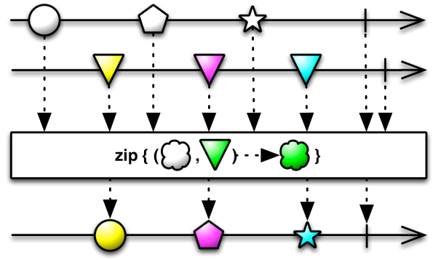
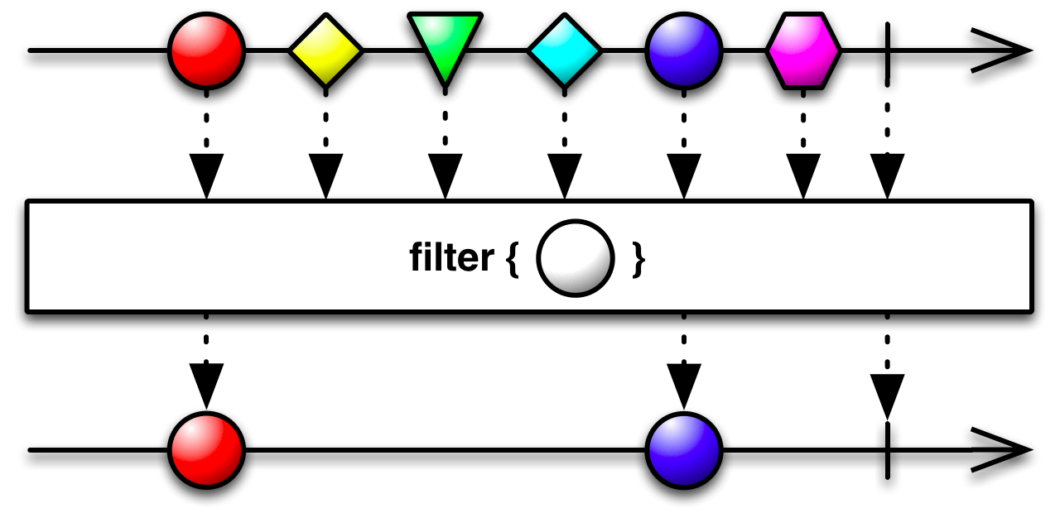
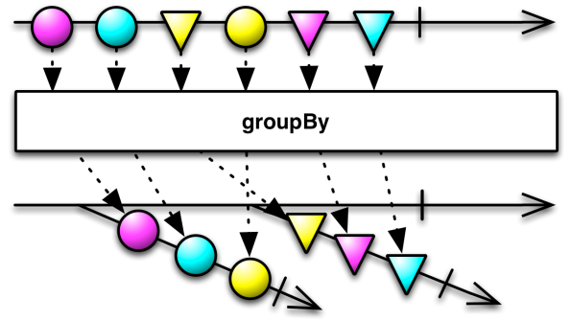
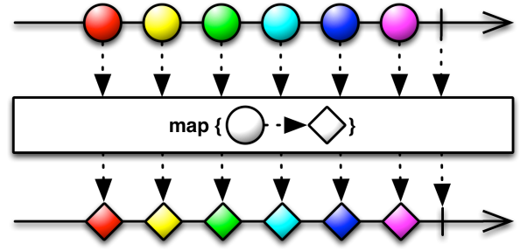
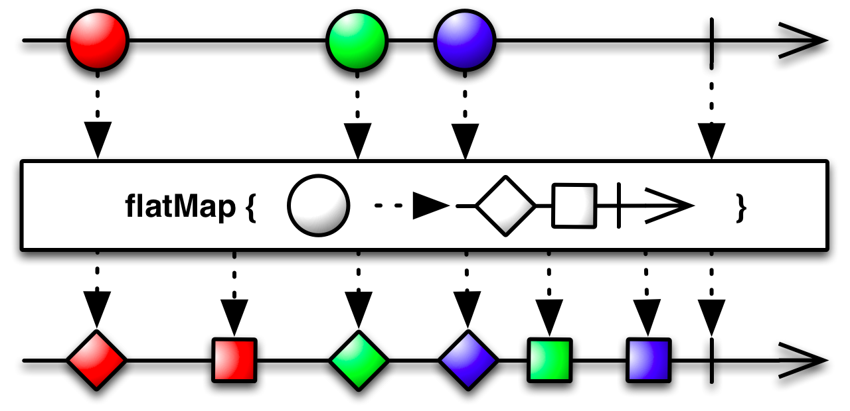
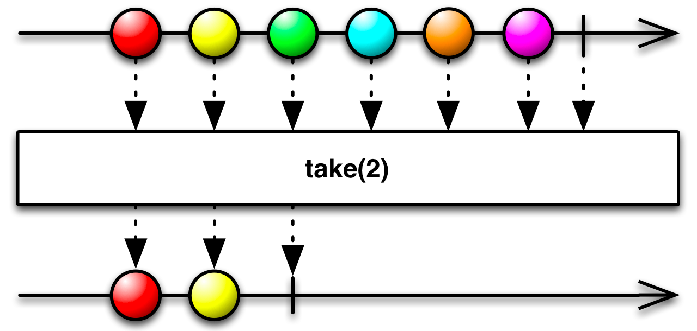
Functional Reactive Libraries Take Us to the Next Level
Asynchronous
Values
Events
Push
Functional Reactive
Lambdas
Closures
Pure Functions
Composable
Move away from request-reply semantics; Trigger streaming data based on events; and use functional operators and combinators to process the streams
http://reactivex.io/documentation/observable.html
Notes:
Functional Reactive Frameworks are based on extending the Observer pattern from Object Oriented Programming, and Stream Processing from Functional Programming. The goal is to build up a series of non-blocking actions by using functional operators and combinators, and then execute by “materializing” or “subscribing”

Slide 54
Recall our 4 key SOA Patterns
 | One | Many
Synchronous | Try[T] | Iterable[T]
Asynchronous | Future[T] | Observable[T]
Asynchronous
Values
Events
Push
Functional Reactive
Lambdas
Closures
Pure Functions
Composable
The reactive architecture goals are best represented by the Observable pattern
It also turns out that the Observable[T] pattern can encapsulate all of the other patterns.
Observable[T] -> Iterable[T]: Observable.from(getCustomers()).toBlockingObservable
Observable[T] -> Future[T]: Trivial, an Observable with a single element
Observable[T] -> Try[T] : Trivial, Observable->Iterable where the Iterable has a single element

Slide 55
Example: Getting a Customer Summary with Functional Reactive Techniques
def customerSummary(custId: Long) :Observable[Map[String,Any]] = {
customerService.getCustomer(custId).flatmap(customer => {
val orders: Map[String,List[Order]] = orderService.getOrders(custId).
take(10) map (olist => Map( “orders” -> olist))
val bills: Map[String,List[Bill]] = billService.getBills(custId)
take(12) map (blist => Map( “bills” -> blist))
val theCust: Map[String, Customer] = Map(“customer”,customer)
Observable.zip(Observable(List( theCust, orders, bills))) map {
theCust ++ orders++ bills
}
} }
//Run It
val custSummary = customerSumary(lookupCustId(“brian.mitchell”)).subscribe

Slide 56
Example: Getting a Customer Summary using Scala
def customerSummary(custId: Long) :Observable[Map[String,Any]] = {
customerService.getCustomer(custId).flatmap(customer => {
val orders: Map[String,List[Order]] = orderService.getOrders(custId).
take(10) map (olist => Map( “orders” -> olist))
val bills: Map[String,List[Bill]] = billService.getBills(custId)
take(12) map (blist => Map( “bills” -> blist))
val theCust: Map[String, Customer] = Map(“customer”,customer)
Observable.zip(Observable(List( theCust, orders, bills))) map {
theCust ++ orders++ bills
}
} }
//Run It
val custSummary = customerSumary(lookupCustId(“brian.mitchell”)).subscribe
STEP 1: Stage a call to the Customer Web Service

Slide 57
Example: Getting a Customer Summary using Scala
def customerSummary(custId: Long) :Observable[Map[String,Any]] = {
customerService.getCustomer(custId).flatmap(customer => {
val orders: Map[String,List[Order]] = orderService.getOrders(custId).
take(10) map (olist => Map( “orders” -> olist))
val bills: Map[String,List[Bill]] = billService.getBills(custId)
take(12) map (blist => Map( “bills” -> blist))
val theCust: Map[String, Customer] = Map(“customer”,customer)
Observable.zip(Observable(List( theCust, orders, bills))) map {
theCust ++ orders++ bills
}
} }
//Run It
val custSummary = customerSumary(lookupCustId(“brian.mitchell”)).subscribe
1
2
3
STEP 2: Use the “flatmap” operator to indicate that you are going to combine some things asynchronously. Specifically data for the last 10 ordersbilling infromation and customer profile data.
NOTE: (1), (2) and (3) ALL EXECUTE CONCURRENTLY

Slide 58
Example: Getting a Customer Summary using Scala
def customerSummary(custId: Long) :Observable[Map[String,Any]] = {
customerService.getCustomer(custId).flatmap(customer => {
val orders: Map[String,List[Order]] = orderService.getOrders(custId).
take(10) map (olist => Map( “orders” -> olist))
val bills: Map[String,List[Bill]] = billService.getBills(custId)
take(12) map (blist => Map( “bills” -> blist))
val theCust: Map[String, Customer] = Map(“customer”,customer)
Observable.zip(Observable(List( theCust, orders, bills))) map {
theCust ++ orders++ bills
}
} }
//Run It
val custSummary = customerSumary(lookupCustId(“brian.mitchell”)).subscribe
STEP 3: Use the “zip” operator to combine the customer, order, and bill objects into a single consolidated object. The ++ operator combines these objects in Scala
NOTE: The zip operator aggregates the concurrent calls merging them once they all return

Slide 59
Example: Getting a Customer Summary using Scala
def customerSummary(custId: Long) :Observable[Map[String,Any]] = {
customerService.getCustomer(custId).flatmap(customer => {
val orders: Map[String,List[Order]] = orderService.getOrders(custId).
take(10) map (olist => Map( “orders” -> olist))
val bills: Map[String,List[Bill]] = billService.getBills(custId)
take(12) map (blist => Map( “bills” -> blist))
val theCust: Map[String, Customer] = Map(“customer”,customer)
Observable.zip(Observable(List( theCust, orders, bills))) map {
theCust ++ orders++ bills
}
} }
//Run It
val custSummary = customerSumary(lookupCustId(“brian.mitchell”)).subscribe
STEP 4: The cusomerSummary function is called but it returns an Observable. Nothing has happened yet! The call to subscribe executes the actions defined in the Observable asynchronously, ultimately the custSummary object is populated with customer, claim and accumulator data.
Examples: custSummary(“customer”).phoneNumber custSummary(“bills”)(0).outstandingBalance
custSummary(“orders”)(0).orderDate

Slide 60
So far we have seen the messaging benefits of reactive streams, but there is more….
the system responds timely with consistent responsiveness
Responsive
responsiveness maintained under varied workloads
responsiveness maintained in the face of failure
Elastic
Resilient
Message Driven
component boundaries traversed using asynchronous messages
Notes:
EAI Frameworks provide patterns for creating higher-level composed abstractions efficiently. They have good support for asynchronous message passing; however, they rely on other technologies for the other reactive aspects that are only partially realized.

Slide 61
Back Pressure
Asynchronous message passing systems work fine when the producer and subscriber are relatively balanced, but problems arise when producers send messages faster than subscribers can consumer them.
Options include dropping messages, or increasing buffering before
running out of memory
Notes:
EAI Frameworks provide patterns for creating higher-level composed abstractions efficiently. They have good support for asynchronous message passing; however, they rely on other technologies for the other reactive aspects that are only partially realized.

Slide 62
Back Pressure – Push versus Pull
Asynchronous message passing systems can work in a “push” or a “pull” mode. In pull mode the subscriber asks the publisher to send data when wants it. In push mode the publisher sends data to the client regardless if its ability to handle it.
Pull mode is slow, and often inefficient because the subscriber need to effectively poll the publisher, especially when the subscriber runs faster than the publisher
Push mode is highly efficient but is also unsafe when the publisher runs faster than the subscriber
Solution: Back pressure is a technique that dynamically switches between pull and push modes as one of the parties starts running faster than the other.
Push Mode: speed (subscriber) ~ speed (publisher)
Push Mode: speed (subscriber) >> speed (publisher)
Pull Mode: speed (subscriber) << speed (publisher)
Notes:
EAI Frameworks provide patterns for creating higher-level composed abstractions efficiently. They have good support for asynchronous message passing; however, they rely on other technologies for the other reactive aspects that are only partially realized.

Slide 63
Revisiting the stream API
Publisher
Subscriber
trait Publisher[T] {
def subscribe(s: Subscriber[T]): Unit
}
trait Subscriber[T] {
def onSubscribe(s: Subscription[T]): Unit def onNext(elem: T): Unit
def onError(t: Throwable): Unit
def onComplete(): Unit
}
trait Subscription[T] {
def cancel(): Unit
def request(n: Long): Unit
}
Subscribe
subscription
onSubscribe
request
onNext
onNext
This is how backpressure is applied
…
onError
onComplete
Note that you can run in pull mode exclusively by calling request(Long.MaxValue)

Slide 64
Backpressure helps address failures in messaging systems plus helps to maintain responsiveness by dynamically balancing the push and pull messaging models
the system responds timely with consistent responsiveness
Responsive
responsiveness maintained under varied workloads
responsiveness maintained in the face of failure
Elastic
Resilient
Message Driven
component boundaries traversed using asynchronous messages
Notes:
EAI Frameworks provide patterns for creating higher-level composed abstractions efficiently. They have good support for asynchronous message passing; however, they rely on other technologies for the other reactive aspects that are only partially realized.

Slide 65
Now lets see how an implementation like akka flushes out our resiliency and elasticity needs
The Akka architecture promotes resiliency and Fault Tolerance via the following:
Failure Hierarchies, Failure Detection, Load Balancing, Clustering, and Distributed Actors Additionally supervisor actors can monitor other actors, adding additional actors to the pool when certain thresholds are met thus promoting elasticity

Slide 66
Now with a runtime like Akka, we have a solution that fully embraces the goals of a reactive architecture
the system responds timely with consistent responsiveness
Responsive
responsiveness maintained under varied workloads
responsiveness maintained in the face of failure
Elastic
Resilient
Message Driven
component boundaries traversed using asynchronous messages
Notes:
EAI Frameworks provide patterns for creating higher-level composed abstractions efficiently. They have good support for asynchronous message passing; however, they rely on other technologies for the other reactive aspects that are only partially realized.

Slide 67
How good are Functional Reactive Frameworks at Implementing a Reactive Architecture?
the system responds timely with consistent responsiveness
Responsive
responsiveness maintained under varied workloads
responsiveness maintained in the face of failure
Elastic
Resilient
Message Driven
component boundaries traversed using asynchronous messages
As the name suggests, Functional Reactive frameworks by their very nature support all of the characteristics of a reactive architecture
Implementations of Functional Reactive Libraries Include: ReactiveX (http://reactivex.io) - Based on the work done at Netflix
ReactiveStreams (http://www.reactive-streams.org) – Based on the work done at Typesafe
Reactor (https://github.com/reactor/reactor) – Based on the work done at Spring/Pivitol
.Net Rx Extensions (https://rx.codeplex.com/) - Seminal Work done at Microsoft

Slide 68
References
Going Reactive by Jonas Boner – http://www.slideshare.net/jboner/going-reactive-eventdriven-scalable-resilient-systems
Reactive Streams - http://www.reactive-streams.org/
ReactiveX - http://reactivex.io/
Akka - http://akka.io/

